Slide 1
Introduction to php
Combined Internet resources from www.php.net/manual and lecturer notes from Prentice Hall.
In other words, external resources.

Slide 2
PHP
Most of this is from the PHP manual online at: http://www.php.net/manual/

Slide 3
What we'll cover
A short history of php
Parsing
Variables
Arrays
Operators
Functions
Control Structures
External Data Files

Slide 4
Background
PHP is server side scripting system
  PHP stands for "PHP: Hypertext Preprocessor"
  Syntax based on Perl, Java, and C
  Very good for creating dynamic content
  Powerful, but somewhat risky!
  If you want to focus on one system for dynamic content, this is a good one to choose

Slide 5
History
Started as a Perl hack in 1994 by Rasmus Lerdorf (to handle his resume), developed to PHP/FI 2.0
By 1997 up to PHP 3.0 with a new parser engine by Zeev Suraski and Andi Gutmans
Version 5.2.4 is current version, rewritten by Zend (www.zend.com) to include a number of features, such as an object model
Current is version 5
php is one of the premier examples of what an open source project can be

Slide 6
PHP Scripts
Typically file ends in .php--this is set by the web server configuration
Separated in files with the <?php ?> tag
php commands can make up an entire file, or can be contained in html--this is a choice….
Program lines end in ";" or you get an error
Server recognizes embedded script and executes
Result is passed to browser, source isn't visible
<P>
<?php $myvar = "Hello World!";
echo $myvar;
?>
</P>

Slide 7
Parsing
We've talk about how the browser can read a text file and process it, that's a basic parsing method
Parsing involves acting on relevant portions of a file and ignoring others
Browsers parse web pages as they load
Web servers with server side technologies like php parse web pages as they are being passed out to the browser
Parsing does represent work, so there is a cost

Slide 8
Two Ways
You can embed sections of php inside html:
Or you can call html from php:
<BODY>
<P>
<?php $myvar = "Hello World!";
echo $myvar;
</BODY>
<?php
echo "<html><head><title>Howdy</title>
…
?>

Slide 9
What do we know already?
Much of what we learned about javascript holds true in php (but not all!), and other languages as well
$name = "bil";
echo "Howdy, my name is $name";
echo "What will $name be in this line?";
echo 'What will $name be in this line?';
echo 'What's wrong with this line?';
if ($name == "bil")
{
// Hey, what's this?
echo "got a match!";
}

Slide 10
Variables
Typed by context (but one can force type), so it's loose
Begin with "$" (unlike javascript!)
Assigned by value
  $foo = "Bob"; $bar = $foo;
Assigned by reference, this links vars
  $bar = &$foo;
Some are preassigned, server and env vars
  For example, there are PHP vars, eg. PHP_SELF, HTTP_GET_VARS
00

Slide 11
phpinfo()
The phpinfo() function shows the php environment
Use this to read system and server variables, setting stored in php.ini, versions, and modules
Notice that many of these data are in arrays
This is the first script you should write…
00_phpinfo.php

Slide 12
Variable Variables
Using the value of a variable as the name of a second variable)
$a = "hello";
$$a = "world";
Thus:
echo "$a ${$a}";
Is the same as:
echo "$a $hello";
But $$a echoes as "$hello"….
00_hello_world.php

Slide 13
Operators
Arithmetic (+, -, *, /, %) and String (.)
Assignment (=) and combined assignment
$a = 3;
$a += 5; // sets $a to 8;
$b = "Hello ";
$b .= "There!"; // sets $b to "Hello There!";
Bitwise (&, |, ^, ~, <<, >>)
  $a ^ $b (Xor: Bits that are set in $a or $b but not both are set.)
  ~ $a (Not: Bits that are set in $a are not set, and vice versa.)
Comparison (==, ===, !=, !==, <, >, <=, >=)

Slide 14
Coercion
Just like javascript, php is loosely typed
Coercion occurs the same way
If you concatenate a number and string, the number becomesa string
17_coercion.php

Slide 15
Operators: The Movie
Error Control (@)
  When this precedes a command, errors generated are ignored (allows custom messages)
Execution (` is similar to the shell_exec() function)
  You can pass a string to the shell for execution:
  $output = `ls -al`;
  $output = shell_exec("ls -al");
  This is one reason to be careful about user set variables!
Incrementing/Decrementing
++$a (Increments by one, then returns $a.)
$a++ (Returns $a, then increments $a by one.)
--$a (Decrements $a by one, then returns $a.)
$a-- (Returns $a, then decrements $a by one.)

Slide 16
Son of the Valley of Operators
Logical
$a and $b And True if both $a and $b are true.
$a or $b Or True if either $a or $b is true.
$a xor $b Xor True if either $a or $b is true,
but not both.
! $a Not True if $a is not true.
$a && $b And True if both $a and $b are true.
$a || $b Or True if either $a or $b is true.
The two ands and ors have different precedence rules, "and" and "or" are lower precedence than "&&" and "||"
Use parentheses to resolve precedence problems or just to be clearer

Slide 17
Control Structures
Wide Variety available
  if, else, elseif
  while, do-while
  for, foreach
  break, continue, switch
  require, include, require_once, include_once

Slide 18
Control Structures
Mostly parallel to what we've covered already in javascript
if, elseif, else, while, for, foreach, break and continue

Slide 19
Switch
Switch, which we've seen, is very useful
These two do the same
things….
switch ($i) {
case 0:
echo "i equals 0";
break;
case 1:
echo "i equals 1";
break;
case 2:
echo "i equals 2";
break;
}
if ($i == 0) {
echo "i equals 0";
} elseif ($i == 1) {
echo "i equals 1";
} elseif ($i == 2) {
echo "i equals 2";
}

Slide 20
Nesting Files
require(), include(), include_once(), require_once() are used to bring in an external file
This lets you use the same chunk of code in a number of pages, or read other kinds of files into your program
Be VERY careful of using these anywhere close to user input--if a hacker can specify the file to be included, that file will execute within your script, with whatever rights your script has (readfile is a good alternative if you just want the file, but don't need to execute it)
Yes, Virginia, remote files can be specified

Slide 21
Example: A Dynamic Table
I hate writing html tables
You can build one in php
This example uses pictures and builds a table with pictures in one column, and captions in another
The captions are drawn from text files
I'm using tables, but you could use css for placement easily…

Slide 22
Arrays
You can create an array with the array function, or use the explode function (this is very useful when reading files into web programs…)
$my_array = array(1, 2, 3, 4, 5);
$pizza = "piece1 piece2 piece3 piece4 piece5 piece6";
$pieces = explode(" ", $pizza);
An array is simply a variable representing a keyed list
  A list of values or variables
  If a variable, that var can also be an array
  Each variable in the list has a key
  The key can be a number or a text label

Slide 23
Arrays
Arrays are lists, or lists of lists, or list of lists of lists, you get the idea--Arrays can be multi-dimensional
Array elements can be addressed by either by number or by name (strings)
If you want to see the structure of an array, use the print_r function to recursively print an array inside of pre tags

Slide 24
Text versus Keys
Text keys work like number keys (well, really, it's the other way around--number keys are just labels)
You assign and call them the same way, except you have to assign the label to the value or variables, eg:
echo "$my_text_array[third]";
$my_text_array = array(first=>1, second=>2, third=>3);
echo "<pre>";
print_r($my_text_array);
echo "</pre>";

Slide 25
Walking Arrays
Use a loop, eg a foreach loop to walk through an array
while loops also work for arrays with numeric keys--just set a variable for the loop, and make sure to increment that variable within the loop
$colors = array('red', 'blue', 'green', 'yellow');
foreach ($colors as $color) {
echo "Do you like $color?\n";
}
05_arrays.php

Slide 26
05_arrays.php
Array
(
[1] => Array
(
[sku] => A13412
[quantity] => 10
[item] => Whirly Widgets
[price] => .50
)
[2] => Array
(
[sku] => A43214
[quantity] => 142
[item] => Widget Nuts
[price] => .05
)
You can't echo an array directly…
  You can walk through an echo or print() line by line
  You can use print_r(), this will show you the structure of complex arrays--that output is to the right, and it's handy for learning the structure of an array

Slide 27
Multidimensional Arrays
A one dimensional array is a list, a spreadsheet or other columnar data is two dimensional…
Basically, you can make an array of arrays
$multiD = array
(
"fruits" => array("myfavorite" => "orange", "yuck" => "banana", "yum" => "apple"),
"numbers" => array(1, 2, 3, 4, 5, 6),
"holes" => array("first", 5 => "second", "third")
);
The structure can be built array by array, or declared with a single statement
You can reference individual elements by nesting:
echo "<p>Yes, we have no " . $multiD["fruits"]["yuck"] . " (ok by me).</p>";
print_r() will show the entire structure, but don’t forget the pre tags
01a_arrays.php

Slide 28
Getting Data into arrays
You can directly read data into individual array slots via a direct assignment:
$pieces[5] = "poulet resistance";
From a file:
  Use the file command to read a delimited file (the delimiter can be any unique char):
  $pizza = file(./our_pizzas.txt)
  Use explode to create an array from a line within a loop:
  $pieces = explode(" ", $pizza);

Slide 29
The Surface
The power of php lies partially in the wealth of functions---for example, the 40+ array functions
  array_flip() swaps keys for values
  array_count_values() returns an associative array of all values in an array, and their frequency
  array_rand() pulls a random element
  array_unique() removes duppies
  array_walk() applies a user defined function to each element of an array (so you can dice all of a dataset)
  count() returns the number of elements in an array
  array_search() returns the key for the first match in an array
08_array_fu.php

Slide 30
Using External Data
You can build dynamic pages with just the information in a php script
But where php shines is in building pages out of external data sources, so that the web pages change when the data does
Most of the time, people think of a database like MySQL as the backend, but you can also use text or other files, LDAP, pretty much anything….

Slide 31
Standard data files
Normally you'd use a tab delimited file, but you can use pretty much anything as a delimiter
Files get read as arrays, one line per slot
Remember each line ends in \n, you should clean this up, and be careful about white space
Once the file is read, you can use explode to break the lines into fields, one at a time, in a loop….

Slide 32
Standard data files
You can use trim() to clean white space and returns instead of str_replace()
Notice that this is building an array of arrays
$items=file("./mydata.txt");
foreach ($items as $line)
{
$line = str_replace("\n", "", $line);
$line = explode("\t", $line);
// do something with $line array
}

Slide 33
Useful string functions
str_replace()
trim(), ltrim(), rtrim()
implode(), explode()
addslashes(), stripslashes()
htmlentities(), html_entity_decode(), htmlspecialchars()
striptags()

Slide 34
06_more_arrays.php
This is a simple script to read and process a text file
The data file is tab delimited and has the column titles as the first line of the file

Slide 35
How it works
The script uses the first line to build text labels for the subsequent lines, so that the array elements can be called by the text label
  If you add a new column, this script compensates
  Text based arrays are not position dependent…
  This script could be the basis of a nice function
There are two version of this, calling two different datafiles, but that's the only difference

Slide 36
06a_more_arrays.php
This version shows how to dynamically build a table in the html output

Slide 37
Alternative syntax
Applies to if, while, for, foreach, and switch
Change the opening brace to a colon
Change the closing brace to an endxxx statement
<?php
if ($a == 5):
echo "a equals 5";
echo "...";
else:
echo "a is not 5";
endif;
?>
<?php if ($a == 5): ?>
A is equal to 5
<?php endif; ?>
07

Slide 38
Sources
http://www.zend.com/zend/art/intro.php
http://www.php.net/
http://hotwired.lycos.com/webmonkey/programming/php/index.html

Slide 39
Chapter 26 - PHP
Outline
26.1 Introduction
26.2 PHP
26.3 String Processing and Regular Expressions
26.4 Viewing Client/Server Environment Variables
26.5 Form Processing and Business Logic
26.6 Verifying a Username and Password
26.7 Connecting to a Database
26.8 Cookies
26.9 Dynamic Content in PHP
26.10 Operator Precedence
26.11 Web Resources

Slide 40
Objectives
In this chapter, you will learn:
  To understand PHP data types, operators, arrays and control structures.
  To understand string processing and regular expressions in PHP.
  To construct programs that process form data.
  To be able to read and write client data using cookies.
  To construct programs that interact with MySQL databases.

Slide 41
26.1 Introduction
PHP
  PHP: Hypertext Preprocessor
  Originally called “Personal Home Page Tools”
  Popular server-side scripting technology
  Open-source
    Anyone may view, modify and redistribute source code
    Supported freely by community
  Platform independent

Slide 42
26.2 PHP
Basic application
  Scripting delimiters
    <? php ?>
    Must enclose all script code
  Variables preceded by $ symbol
    Case-sensitive
  End statements with semicolon
  Comments
    // for single line
    /* */ for multiline
  Filenames end with .php by convention

Slide 43
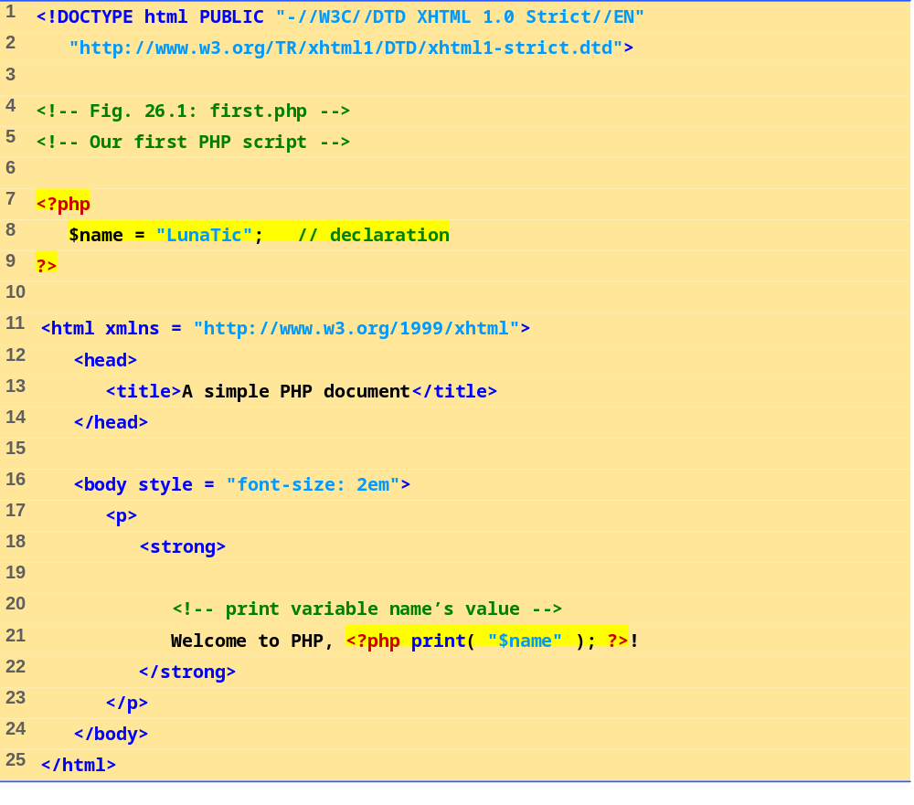
first.php
(1 of 1)
Scripting delimiters
Declare variable $name
Single-line comment
Function print outputs the value of variable $name

Slide 44
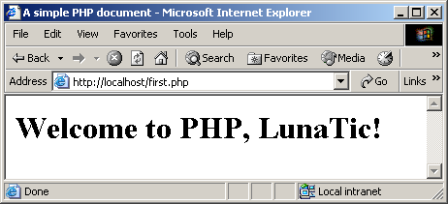
26.2 PHP
Fig. 26.1 Simple PHP program.

Slide 45
26.2 PHP
Variables
  Can have different types at different times
  Variable names inside strings replaced by their value
  Type conversions
    settype function
    Type casting
  Concatenation operator
    . (period)
    Combine strings

Slide 46
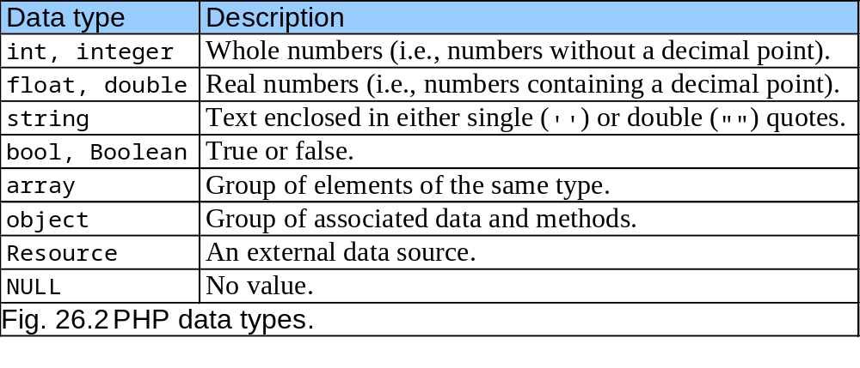
26.2 PHP

Slide 47
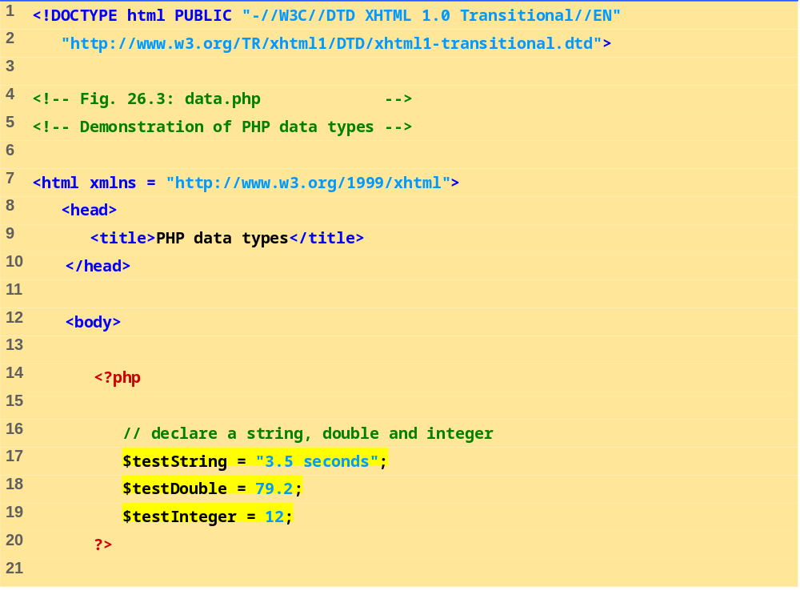
data.php
(1 of 3)
Assign a string to variable $testString
Assign a double to variable $testDouble
Assign an integer to variable $testInteger

Slide 48
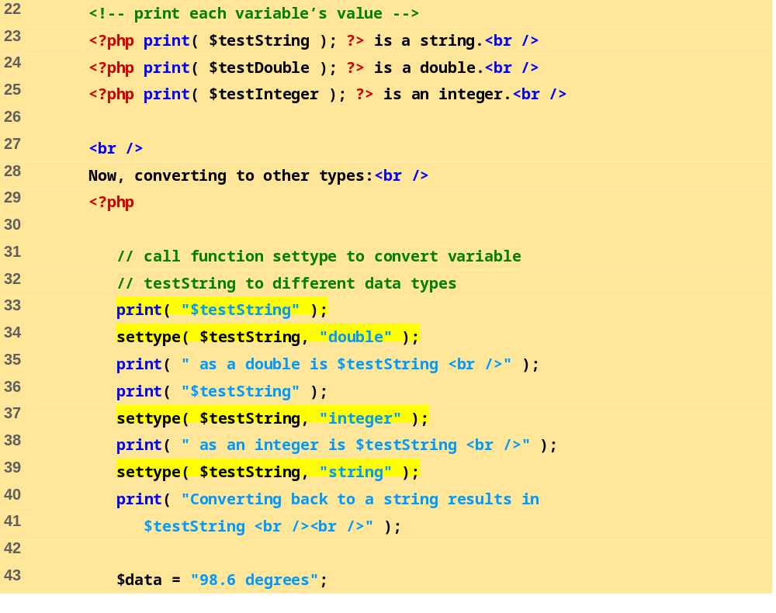
data.php
(2 of 3)
Print each variable’s value
Call function settype to convert the data type of variable $testString to a double.
Call function settype to convert the data type of variable $testString to an integer.
Convert variable $testString back to a string

Slide 49
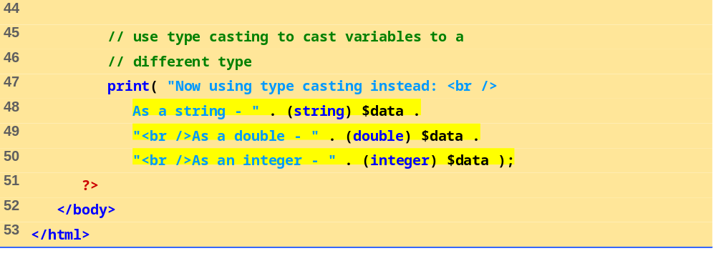
data.php
(3 of 3)
Use type casting to cast variable $data to different types

Slide 50
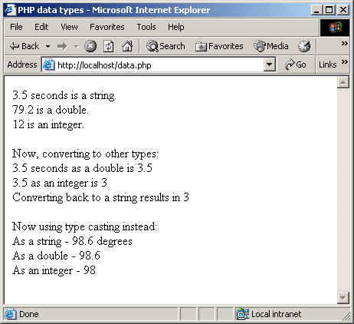
26.2 PHP
Fig. 26.3 Type conversion.

Slide 51
26.2 PHP
Arithmetic operators
  Assignment operators
    Syntactical shortcuts
    Before being assigned values, variables have value undef
Constants
  Named values
  define function

Slide 52
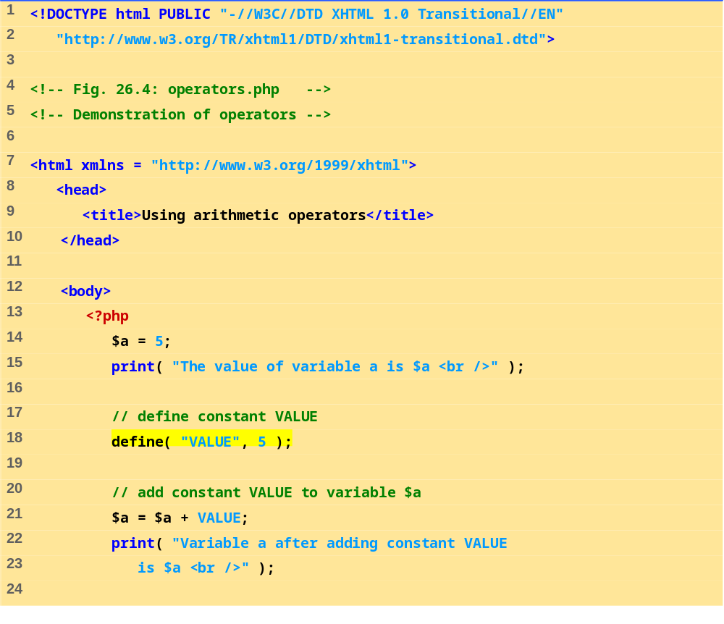
operators.php
(1 of 3)
Define constant VALUE.
Add constant VALUE to variable $a.

Slide 53
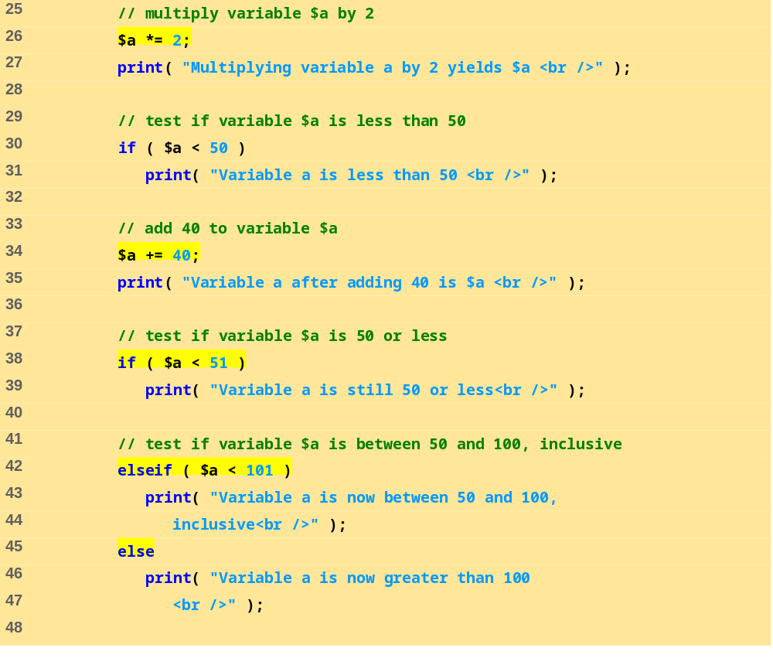
operators.php
(2 of 3)
Multiply variable $a by two using the multiplication assignment operator *=.
Test whether variable $a is less than 50
Print if variable $a is less than 50.
Add 40 to variable $a using the addition assignment operator +=.

Slide 54
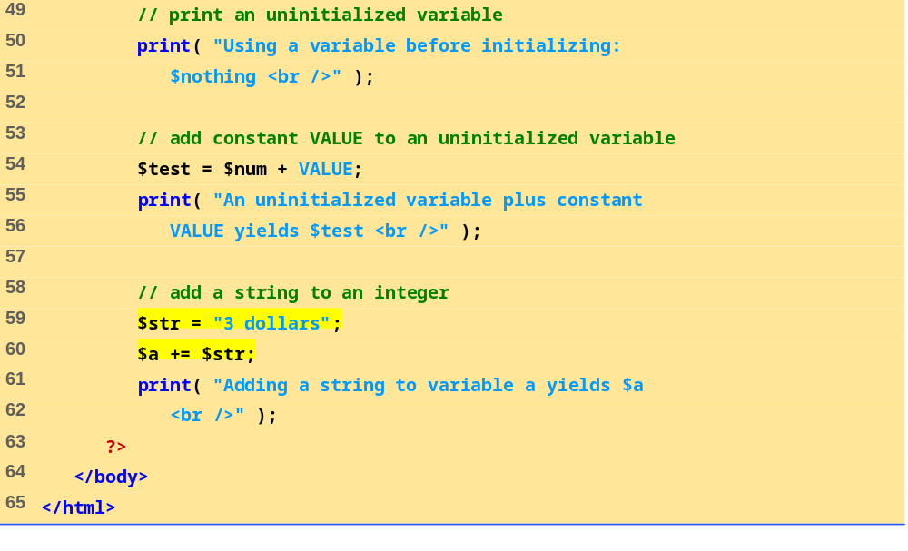
operators.php
(3 of 3)
Print an uninitialized variable ($nothing).
Add constant VALUE to an uninitialized variable.
Add a string to an integer.

Slide 55
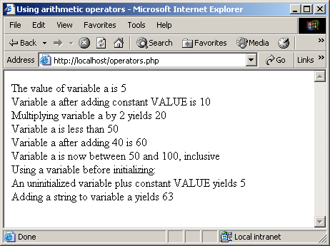
26.2 PHP
Fig. 26.4 Using PHP’s arithmetic operators.

Slide 56
26.2 PHP
Keywords
  Reserved for language features
  if…elseif…else
Arrays
  Group of related data
    Elements
  Name plus braces and index
    Indices start at zero
  count function
  array function

Slide 57
26.2 PHP
Arrays, cont.
  Built-in iterators
    Maintain pointer to element currently referenced
    reset
    key
    next
    foreach loops

Slide 58
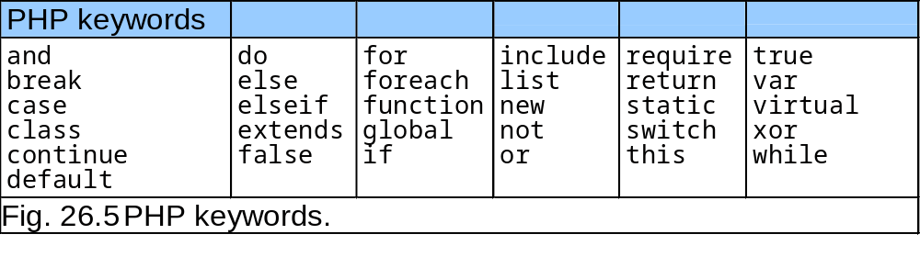
26.2 PHP

Slide 59
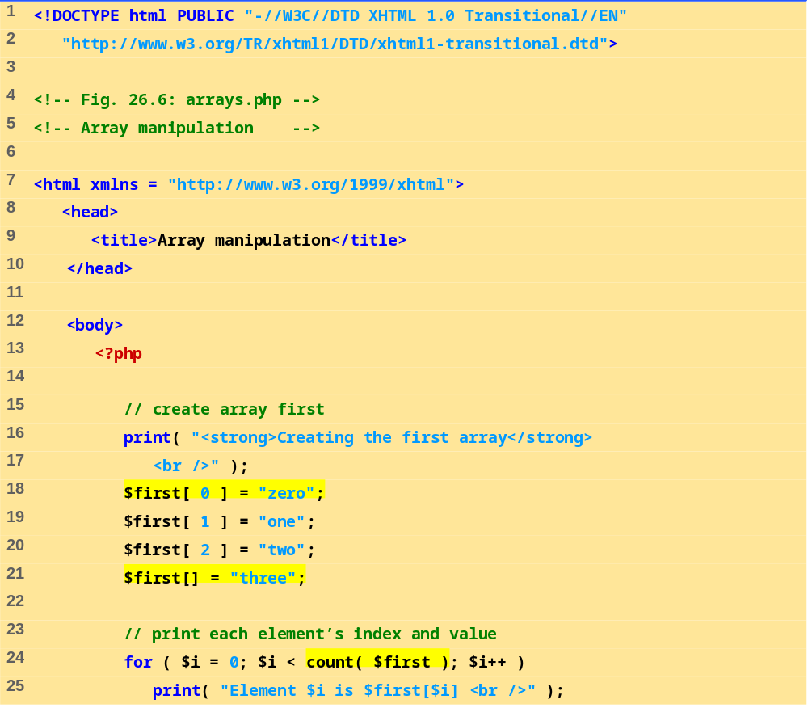
arrays.php
(1 of 3)
Create the array $first by assigning a value to an array element.
Assign a value to the array, omitting the index. Appends a new element to the end of the array.
Use a for loop to print out each element’s index and value. Function count returns the total number of elements in the array.

Slide 60
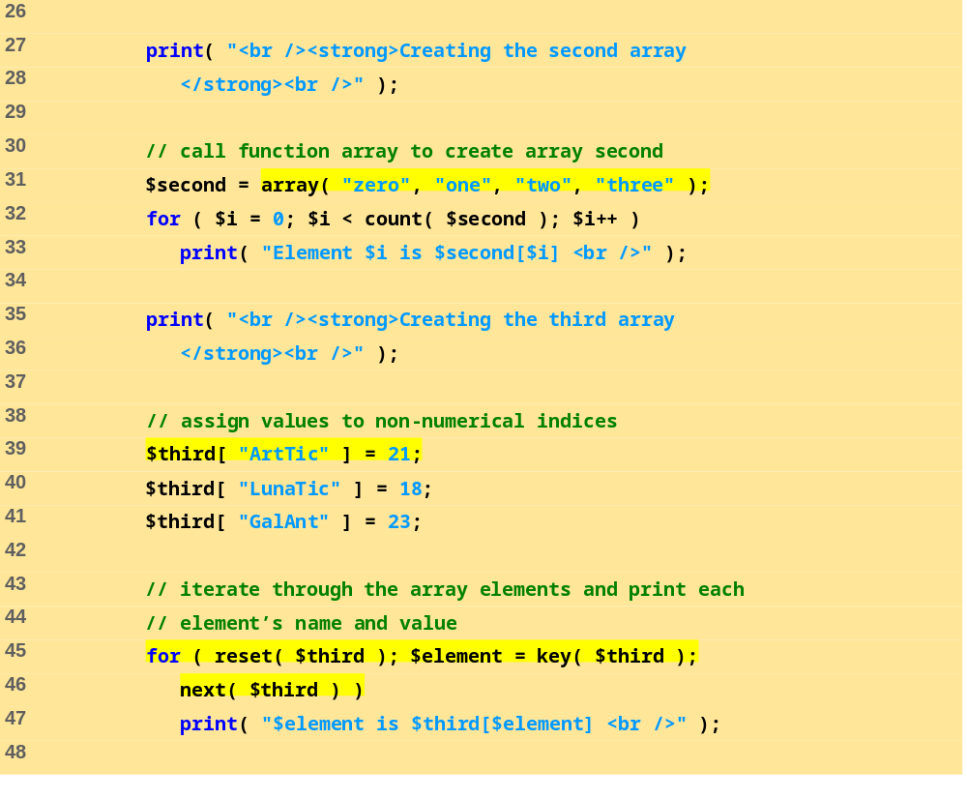
arrays.php
(2 of 3)
Call function array to create an array that contains the arguments passed to it. Store the array in variable $second.
Assign values to non-numerical indices in array $third.
Function reset sets the internal pointer to the first element of the array.
Function key returns the index of the element which the internal pointer references.
Function next moves the internal pointer to the next element.

Slide 61
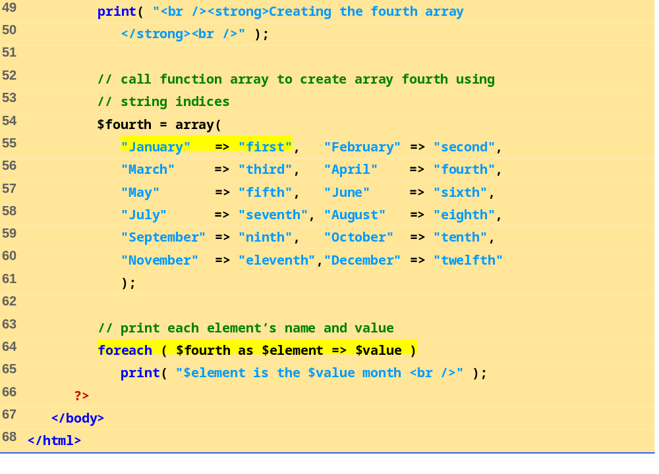
arrays.php
(3 of 3)
Operator => is used in function array to assign each element a string index. The value to the left of the operator is the array index, and the value to the right is the element’s value.

Slide 62
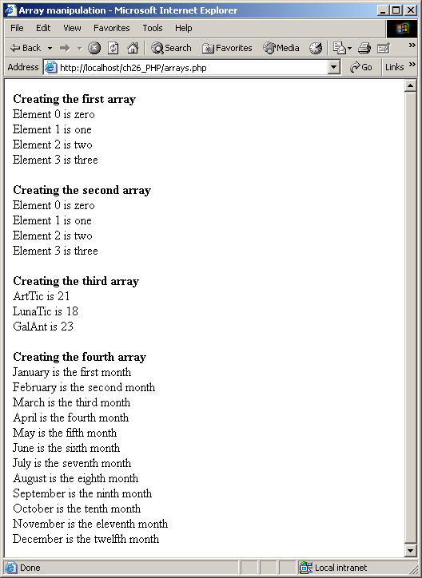
26.2 PHP
Fig. 26.6 Array manipulation.

Slide 63
26.3 String Processing and Regular Expressions
String processing
  Equality and comparison two important operations
  strcmp function
    Returns –1 if string 1 < string 2
    Returns 0 if string 1 = string 2
    Returns 1 if string 1 > string 2
  Relational operators

Slide 64
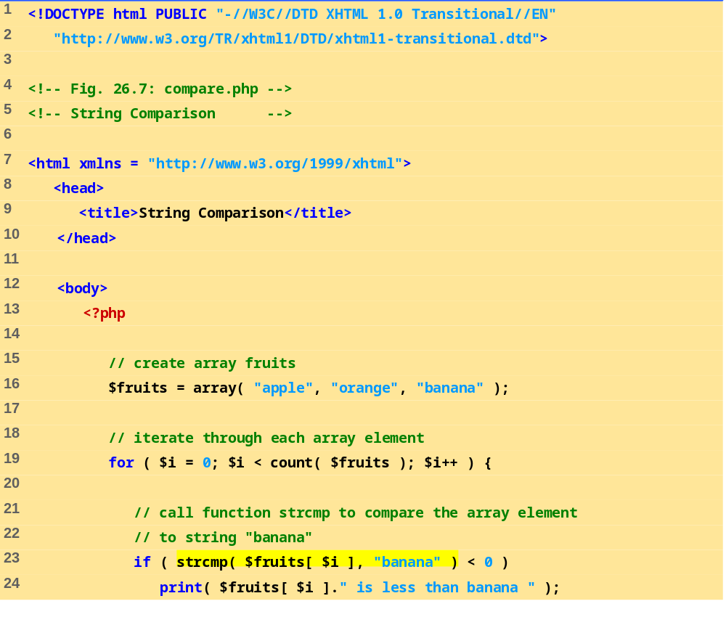
compare.php
(1 of 2)
Use a for loop to iterate through each array element.
Function strcmp compares two strings. If the first string alphabetically precedes the second, then –1 is returned. If the strings are equal, 0 is returned. If the first string alphabetically follows the second, then 1 is returned.

Slide 65
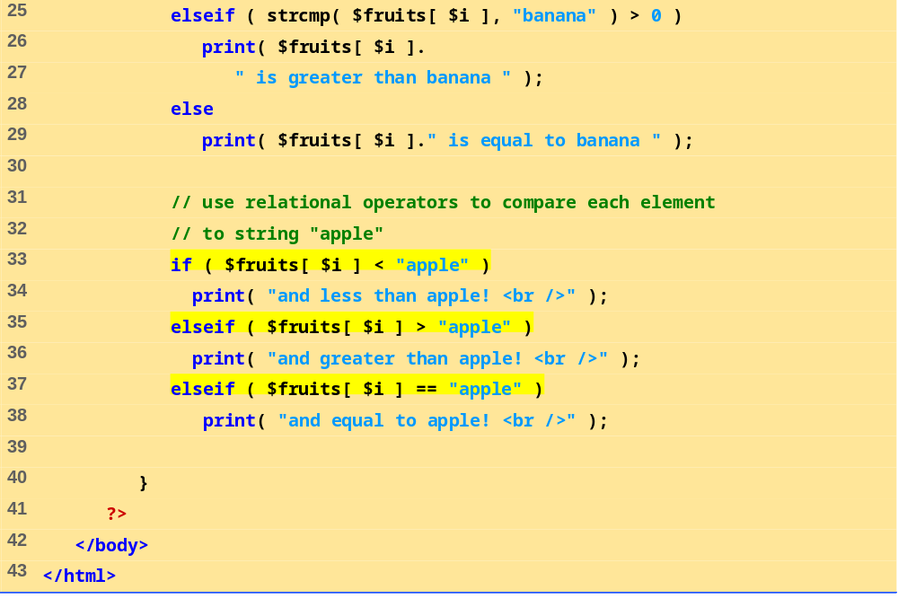
compare.php
(2 of 2)
Use relational operators to compare each array element to string “apple”.

Slide 66
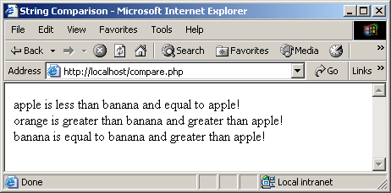
26.3 String Processing and Regular Expressions
Fig. 26.7 Using the string comparison operators.

Slide 67
26.3 String Processing and Regular Expressions
Regular expressions
  Pattern matching templates
  ereg function
    POSIX
  preg_match function
    Perl
  ereg_replace function
Building regular expressions
  Metacharacters
    $, ., ^
  Brackets [ ]

Slide 68
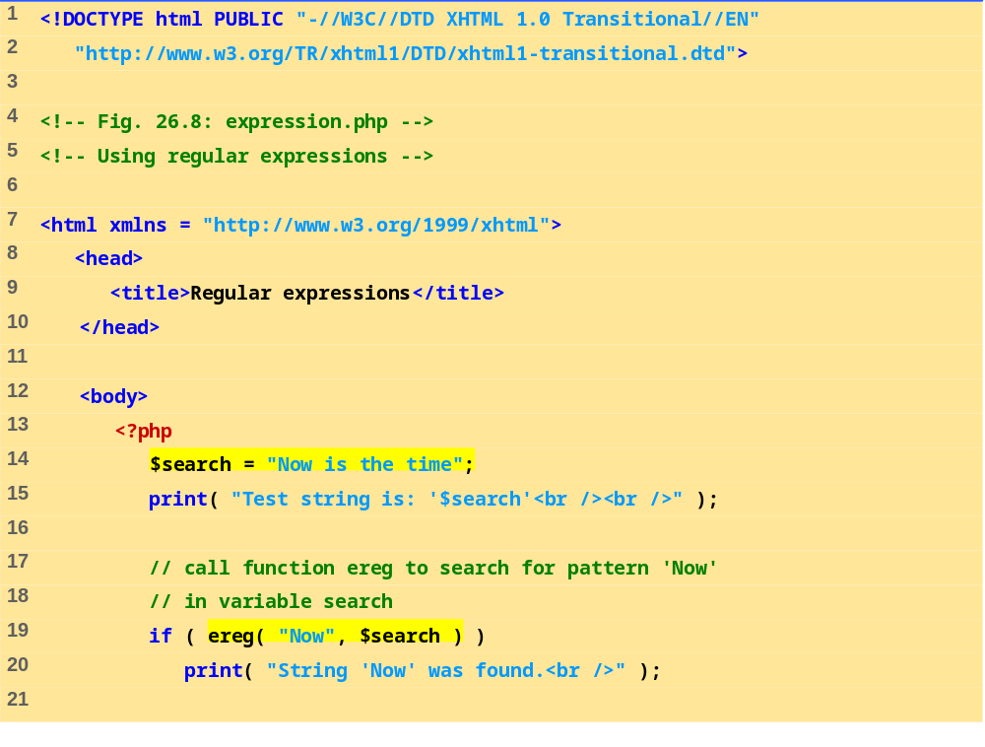
expression.php
(1 of 3)
Function ereg searches for the literal characters Now inside variable $search.

Slide 69
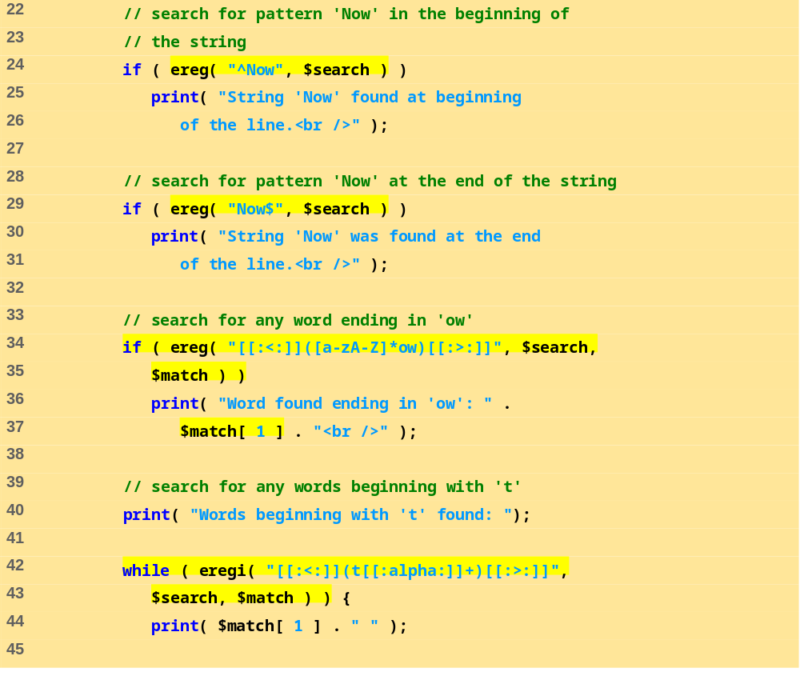
expression.php
(2 of 3)
The dollar sign special character ($) search for the pattern Now at the end of the string.
The caret special character (^) matches the beginning of a string. Function ereg searches the beginning of the string for pattern Now .
The expression inside the parentheses, [a-zA-Z]*ow, matches any word ending in ow. The quantifier * matches the preceding pattern 0 or more times.
The special bracket expressions [[:<:]] and [[:>:]] match the beginning and end of a word, respectively.
Placing a pattern in parentheses stores the matched string in the array that is specified in the third argument to function ereg.
The pattern used in this example, [[:<:]](t[[:alpha:]]+)[[:>:]], matches any word beginning with the character t followed by one or more characters. Character class [[:alpha:]] recognizes any alphabetic character.
The while loop is used to find each occurrence of a word in the string beginning with t.
Function eregi is used to specify case insensitive pattern matches.

Slide 70
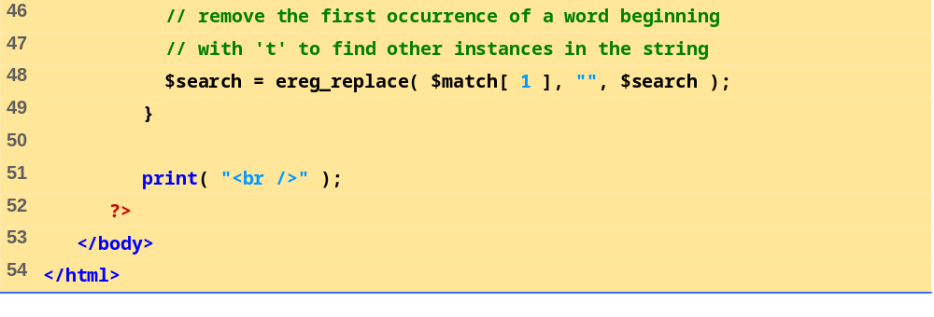
expression.php
(3 of 3)
After printing a match of a word beginning with t, function ereg_replace is called to remove the word from the string. This is necessary be because to find multiple instances of a given pattern, the first matched instance must first be removed. Function ereg_replace takes three arguments: the pattern to match, a string to replace the matched string and the string to search.

Slide 71
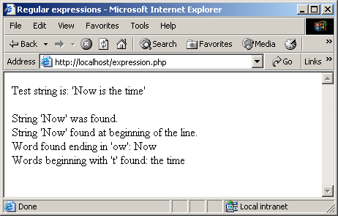
26.3 String Processing and Regular Expressions
Fig. 26.8 Regular expressions in PHP.

Slide 72
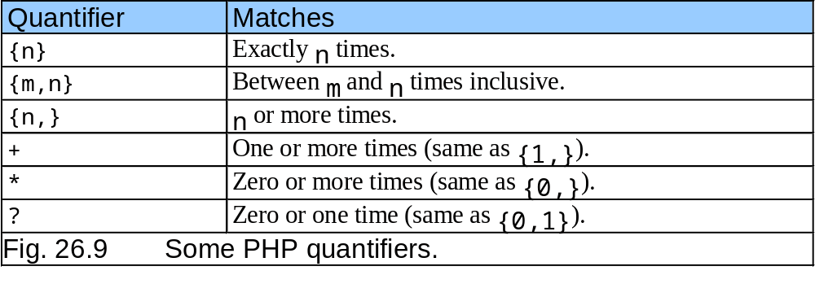
26.3 String Processing and Regular Expressions

Slide 73
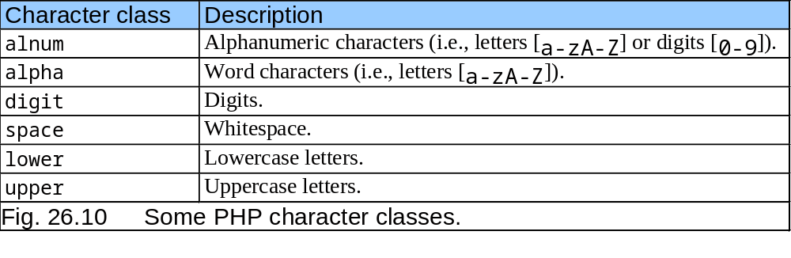
26.3 String Processing and Regular Expressions

Slide 74
26.4 Viewing Client/Server Environment Variables
Environment variables
  Provide information about execution environment
    Type of Web browser
    Type of server
    Details of HTTP connection
  Stored as array in PHP
    $_ENV

Slide 75
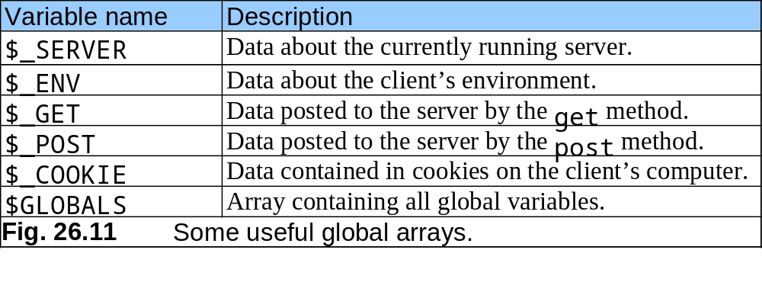
26.4 Viewing Client/Server Environment Variables

Slide 76
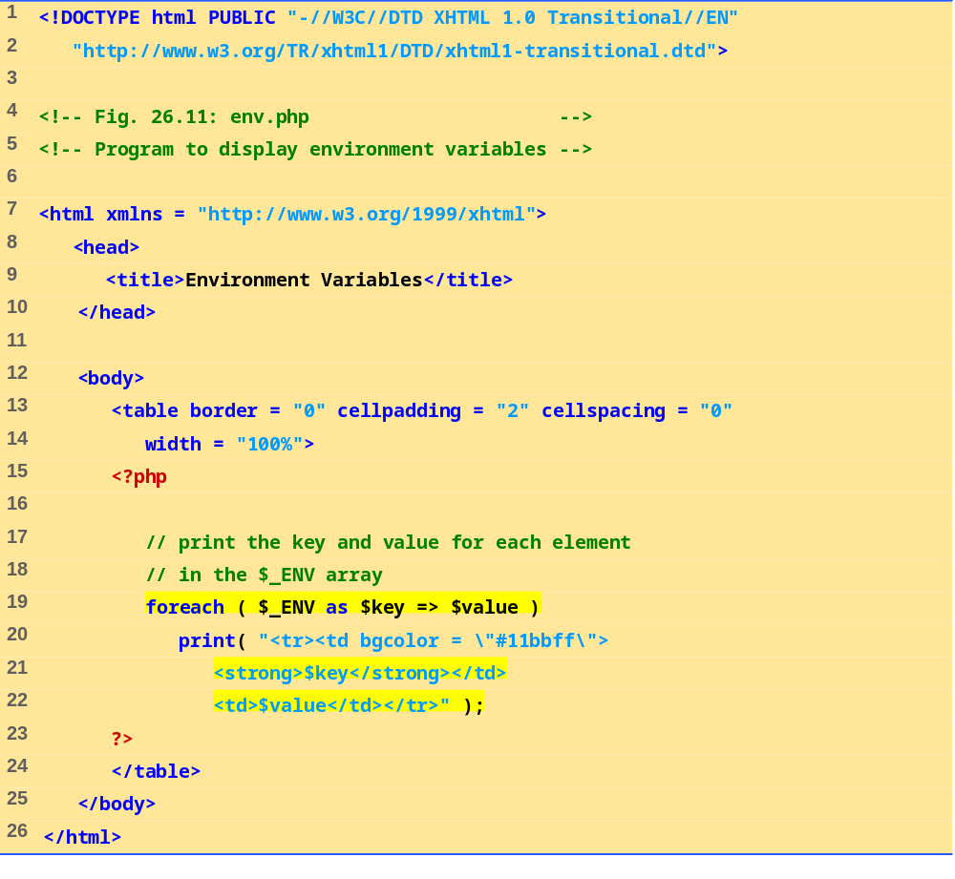
env.php
(1 of 1)
The foreach loop is used to print out the keys and values for each element in the $_ENV array.
PHP stores environment variables and their values in the $_ENV array.

Slide 77
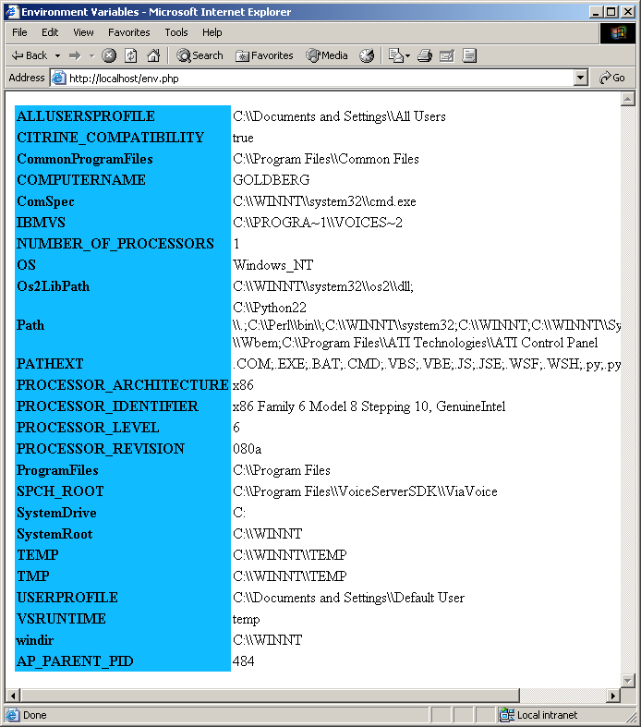
26.4 Viewing Client/Server Environment Variables
Fig. 26.12 Displaying environment variables.

Slide 78
26.5 Form Processing and Business Logic
Form processing
  action property
    Where to send form data
  method property
    post
  Each element has unique name

Slide 79
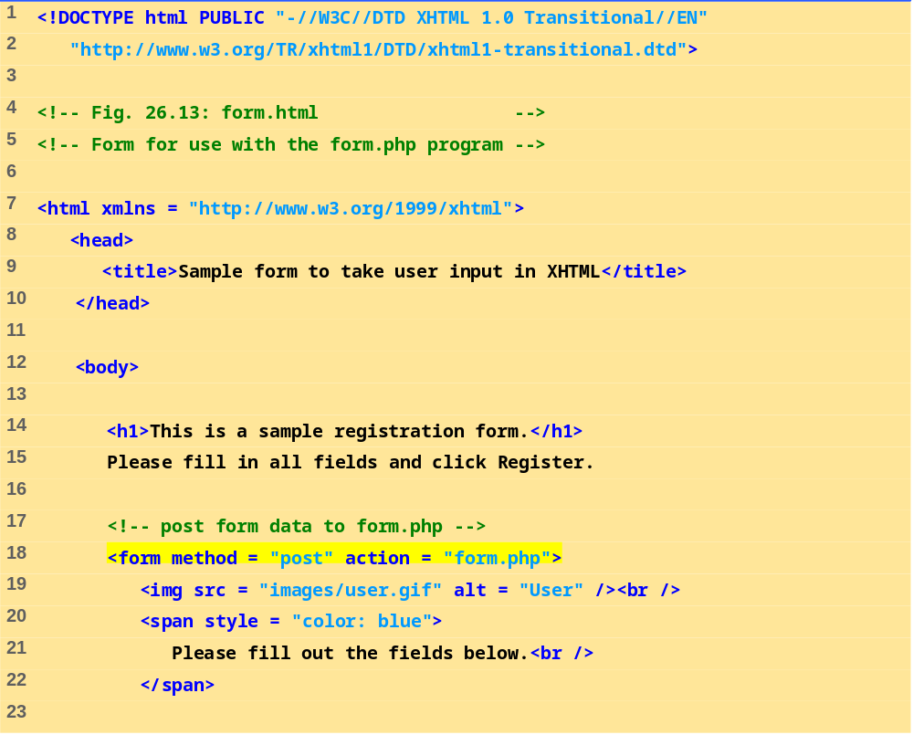
form.html
(1 of 4)
The action attribute of the form element indicates that when the user clicks Register, the form data will be posted to form.php.

Slide 80
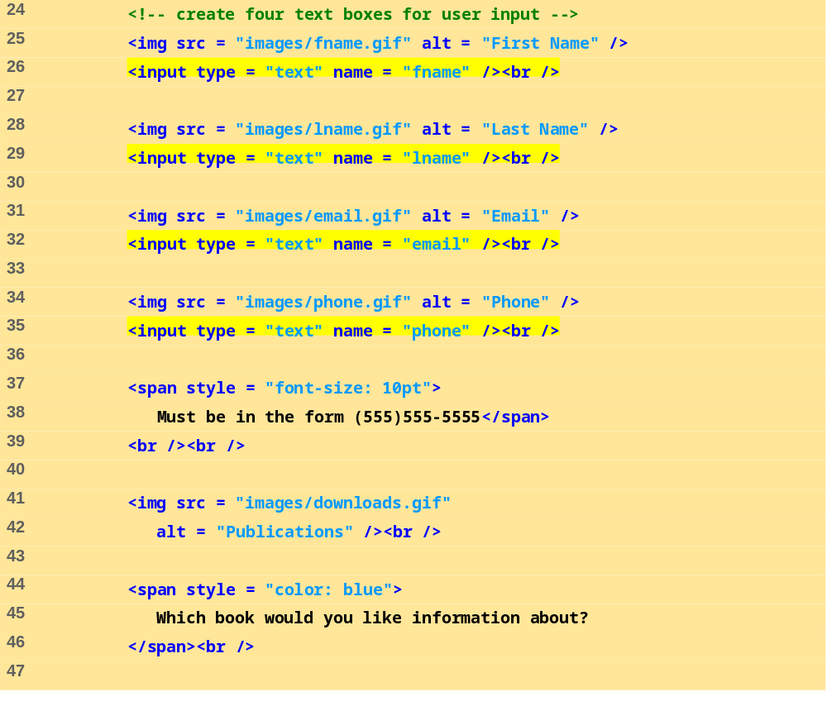
form.html
(2 of 4)
A unique name (e.g., email) is assigned to each of the form’s input fields. When Register is clicked, each field’s name and value are sent to the Web server.

Slide 81
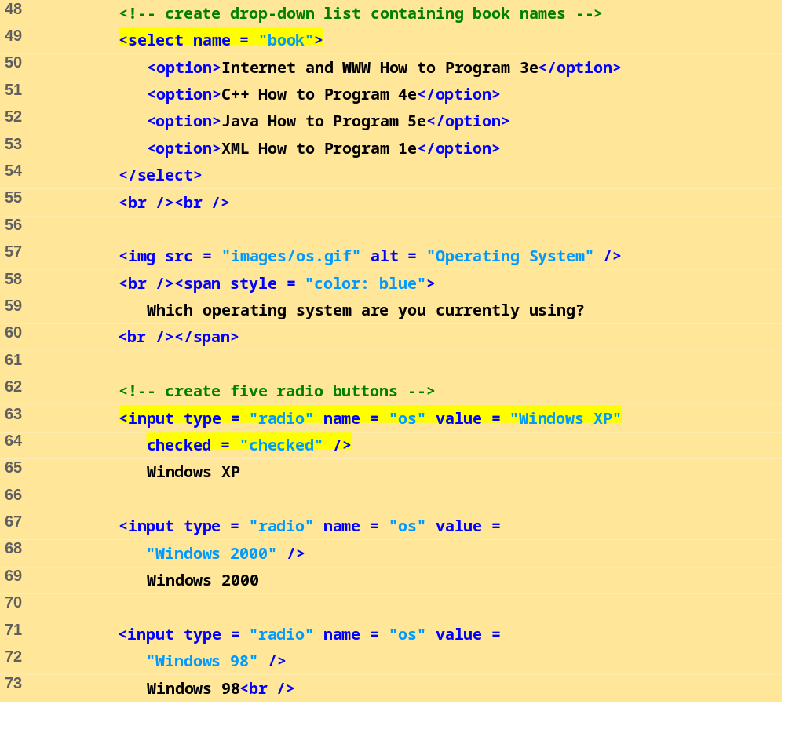
form.html
(3 of 4)

Slide 82
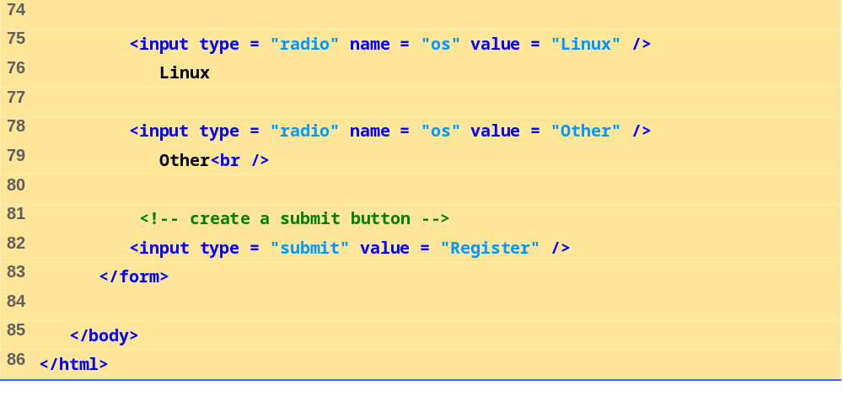
form.html
(4 of 4)

Slide 83
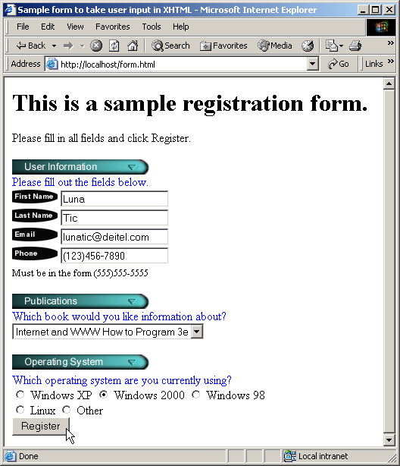
26.5 Form Processing and Business Logic
Fig. 26.13 XHTML form for gathering user input.

Slide 84
26.5 Form Processing and Business Logic
Business logic
  Confirm that valid information was entered
  extract function
    Creates variables corresponding to each key-value pair in array
    Easily retrieve all values sent to PHP page
  Regular expressions very helpful
  Do checks on client side where possible
    JavaScript
    Conserves server resources
Ending a script
  die function
    Remember to close all HTML tags

Slide 85
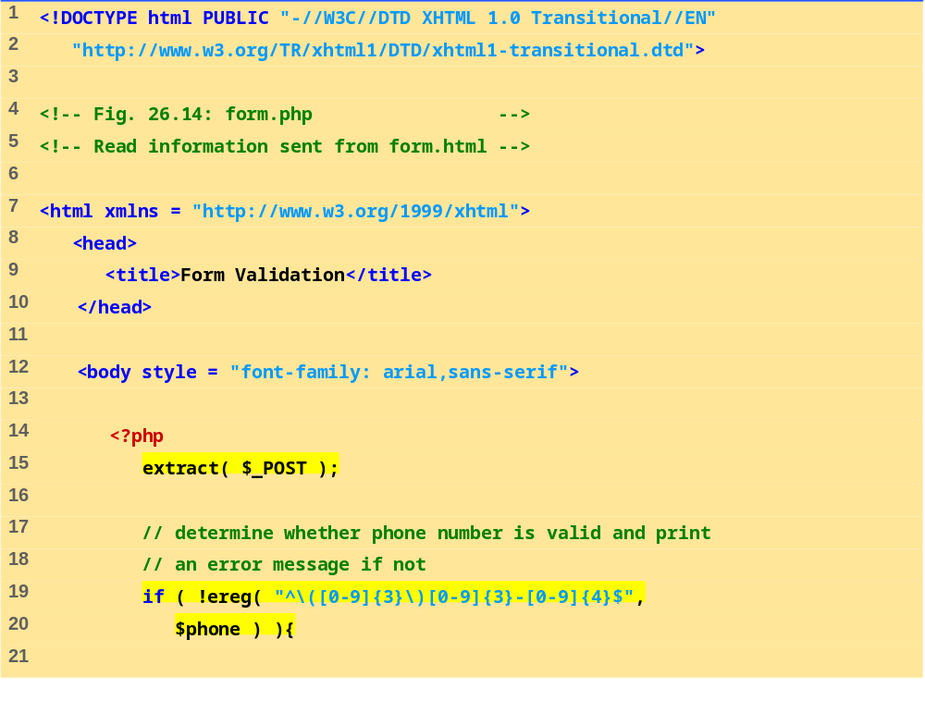
form.php
(1 of 4)
Function ereg is called to determine whether the phone number entered by the user is valid.
The parentheses in the expression must be followed by three digits ([0-9]{3}), a closing parenthesis, three digits, a literal hyphen and four additional digits.
The expression \( matches the opening parentheses of a phone number.
We access the phone field’s value from form.html by using variable $phone.

Slide 86
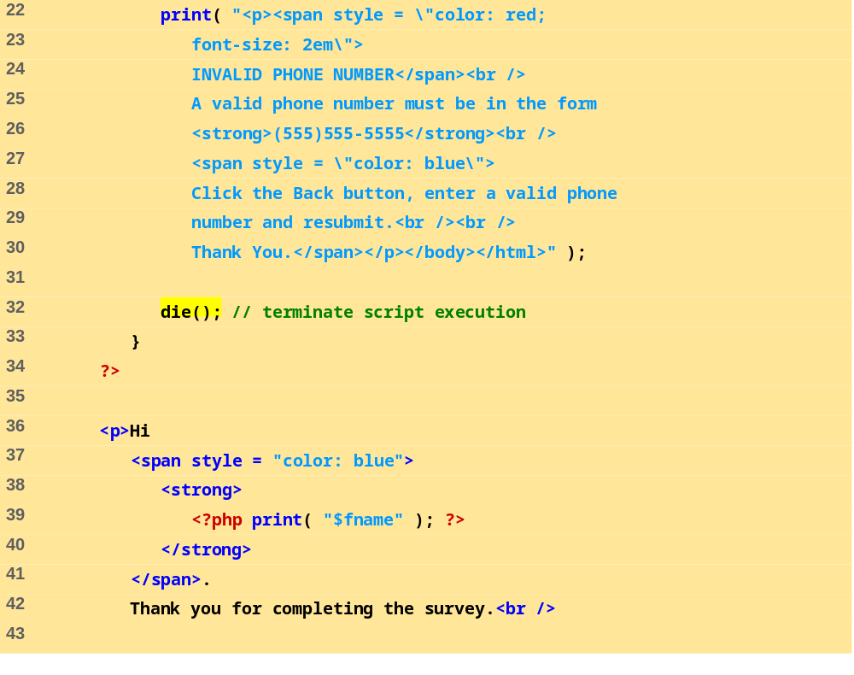
form.php
(2 of 4)
Function die terminates script execution

Slide 87
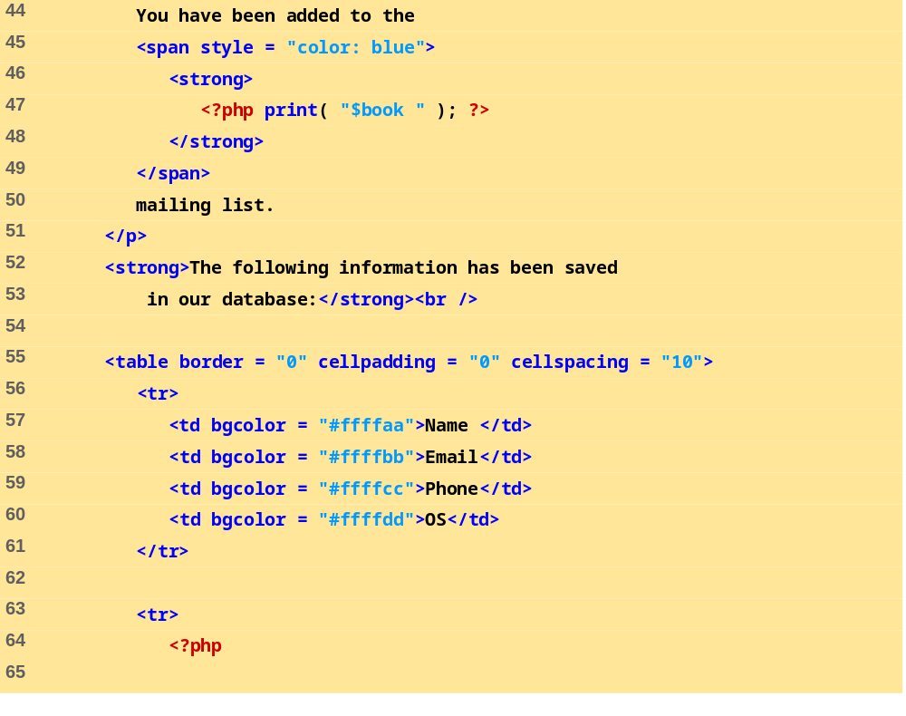
form.php
(3 of 4)

Slide 88
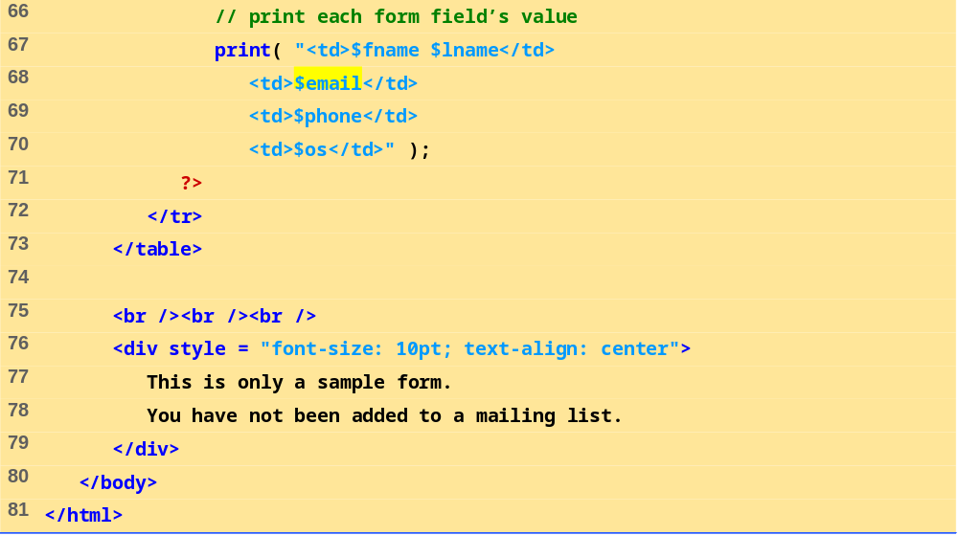
form.php
(4 of 4)

Slide 89
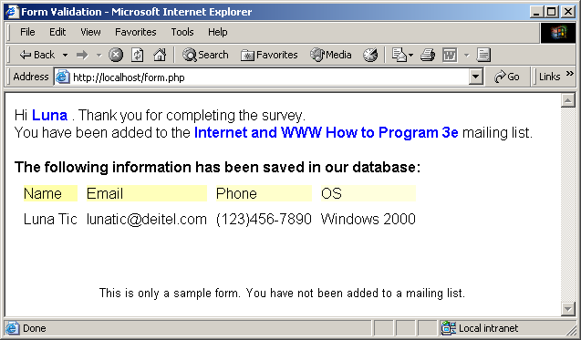
26.5 Form Processing and Business Logic
Fig. 26.14 Obtaining user input through forms.

Slide 90
26.6 Verifying a Username and Password
Private website
  Only accessible to certain individuals
  Encrypt username and password data when sending, storing and retrieving for increased security
Implementing password checking
  Login information stored in file
    fopen function
    Read, write, append modes
  Store data using fputs
    \n newline character
  Close files when done
    fclose function

Slide 91
26.6 Verifying a Username and Password
Implementing password checking, cont.
  Trim newline character
    chop function
  Split string into substrings given a certain delimiter
    split function
  If username/password match list, allow access

Slide 92
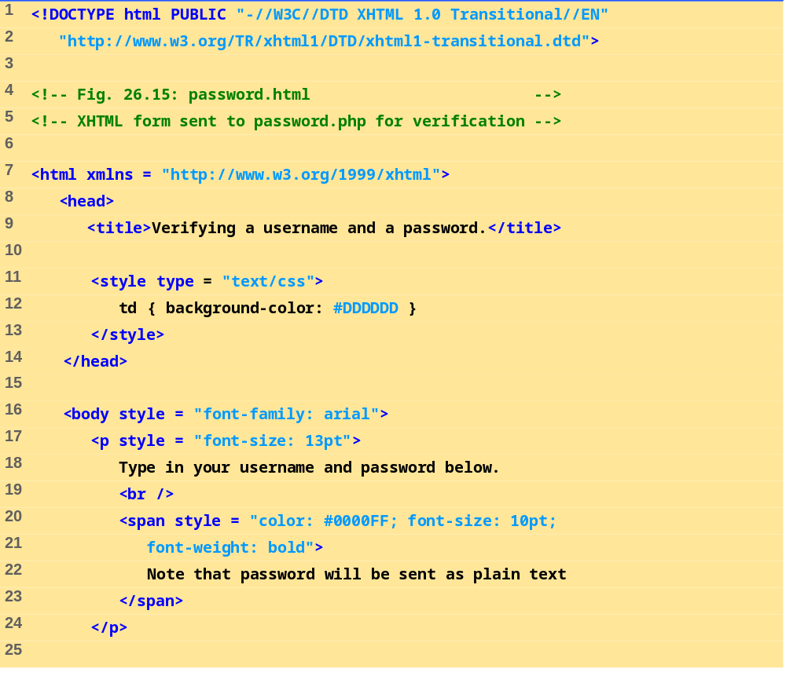
password.html
(1 of 4)

Slide 93
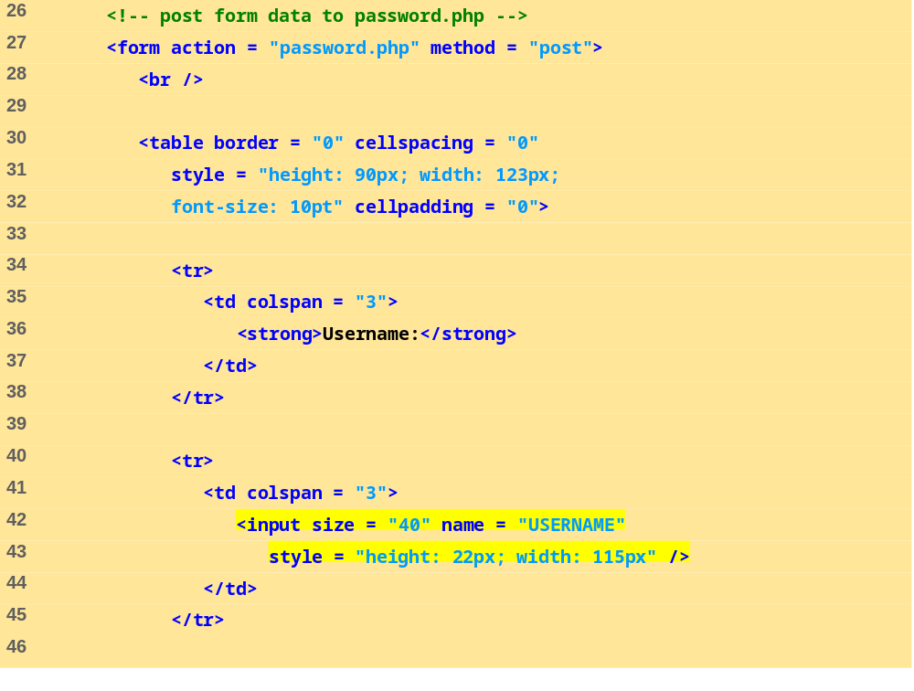
password.html
(2 of 4)
Form data is posted to password.php.

Slide 94
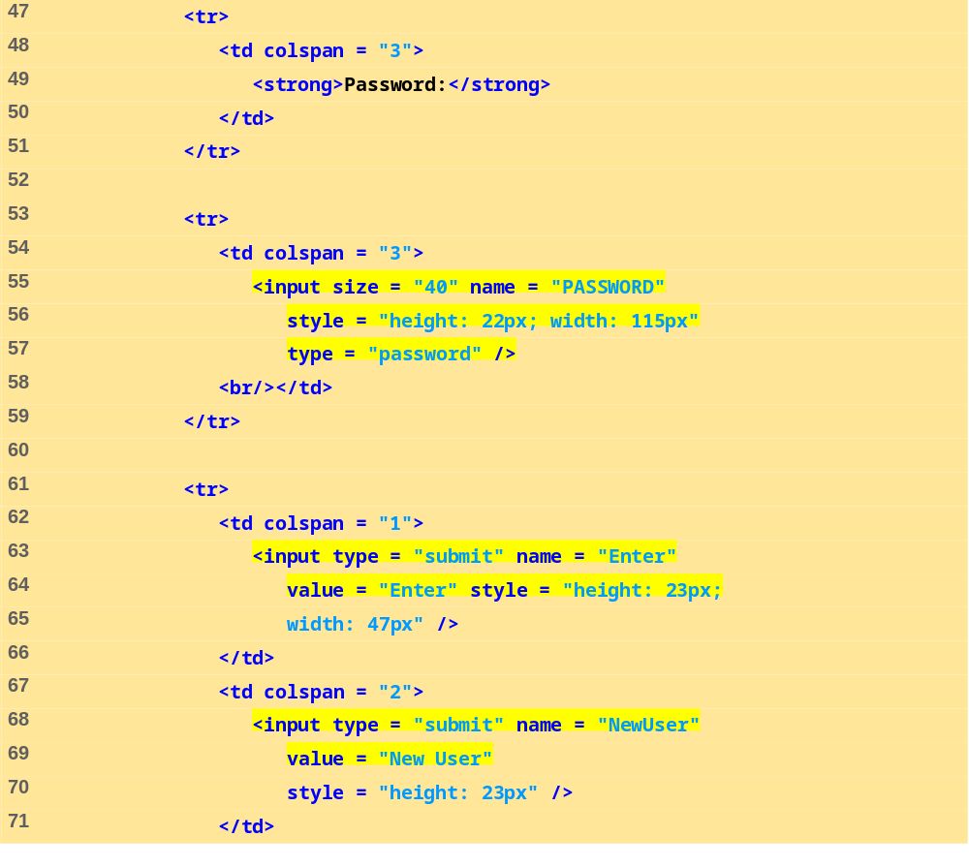
password.html
(3 of 4)

Slide 95
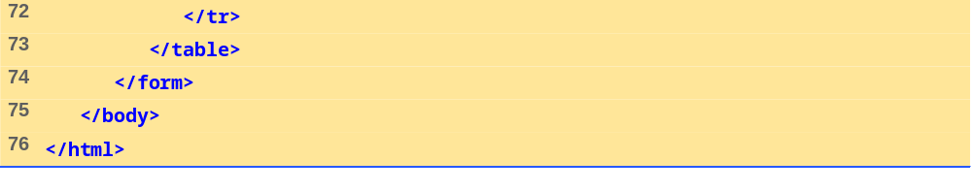
password.html
(4 of 4)

Slide 96
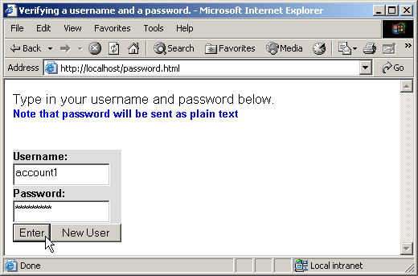
26.6 Verifying a Username and Password
Fig. 26.15 XHTML form for obtaining a username and password.

Slide 97
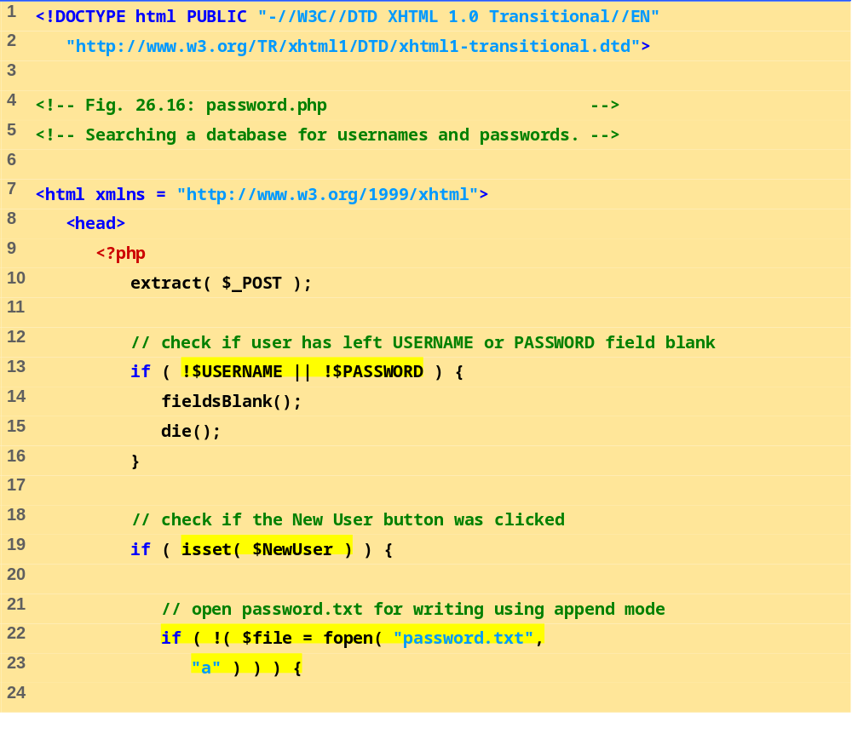
password.php
(1 of 7)
Variable names, when preceded by the logical negation operator (!), return true if they are empty or set to 0. This checks if a user has submitted a form without specifying a username or password.
Function fieldsBlank is called if the user has submitted an incomplete form to notify the user that all form fields must be completed.
Function isset tests whether the user has pressed the New User button, indicating that a new user must be added.
To add a new user, we open the file password.txt in append mode and assign the file handle that is returned to variable $file.

Slide 98
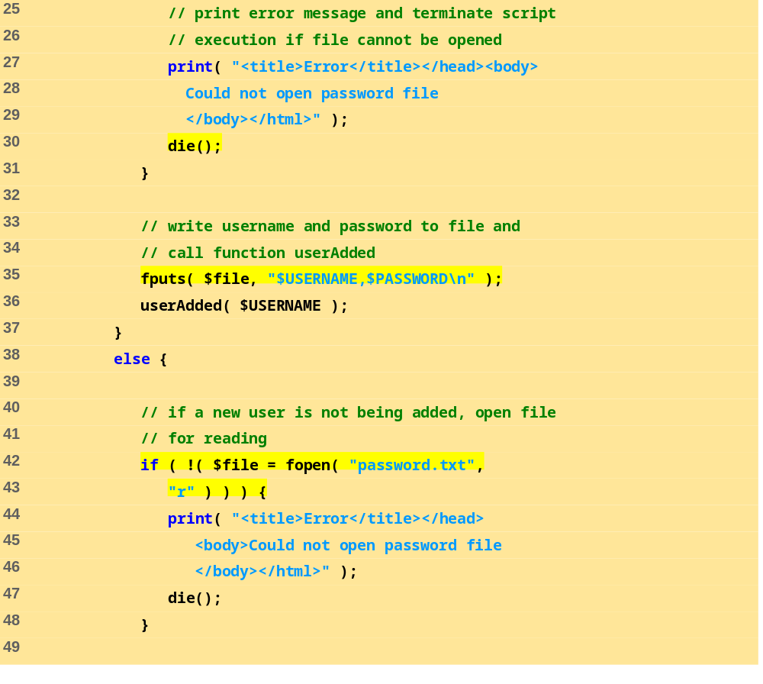
password.php
(2 of 7)
Print an error message and terminate script execution if the file cannot be opened.
Function userAdded is called to print a message to the user to indicate that the username and password were added to the file.
Function fputs writes the name and password to the text file..

Slide 99
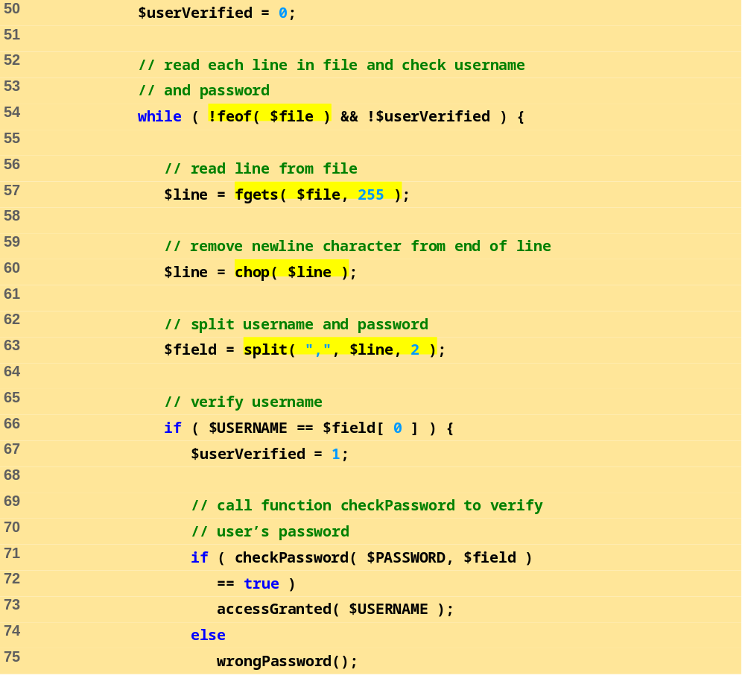
password.php
(3 of 7)
Before entering the while loop, variable $userVerified is set to 0.
Function fgets reads a line from the text file. The result is assigned to variable $line.
The while loop executes as long as the there are more lines in the file to read and variable $userVerified is still 0 or empty.
Function chop removes the newline character from the end of the line.
Function split is called to separate the string at the specified delimiter (in this case, a comma). The resulting array is stored in array $field.
The username entered by the user is tested against the one returned in the text file (stored in the first element of the array). If they match, variable $userVerified is set to 1.
If function checkPassword returns true, function accessGranted is called to notify the client that permission has been granted. Otherwise, function wrongPassword is called.
Function checkPassword is called to verify the user’s password. Variable $PASSWORD and array $field are passed to the function.

Slide 100
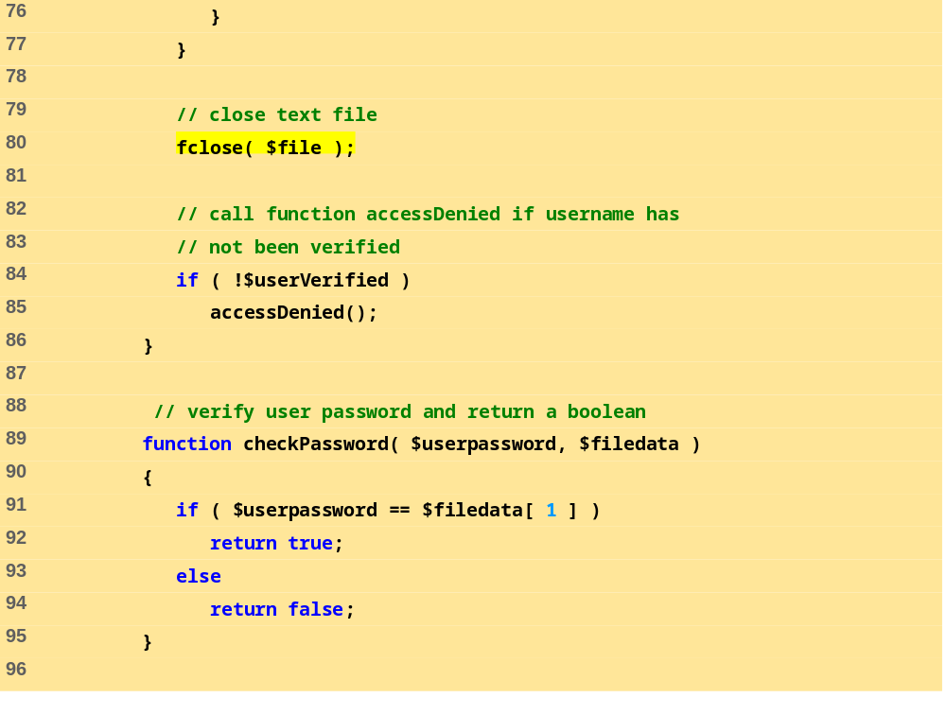
password.php
(4 of 7)
If variable $userVerified has not been set to a value other than 0, function accessDenied is called to notify the client that access has been denied.
After the while loop has executed, function fclose is called to close the file.
Function checkPassword compares the user’s password to the password in the file. If they match, true is returned, whereas false is returned if they do not.

Slide 101
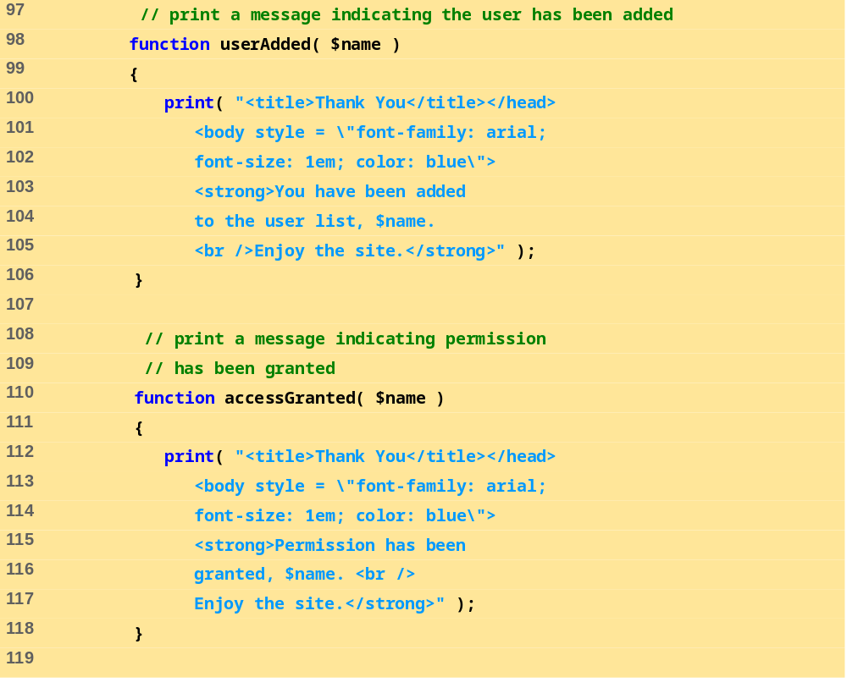
password.php
(5 of 7)
Function userAdded prints a message to the client indicating that the user has been added.
Function accessGranted prints a message to the client indicating that permission has been granted.

Slide 102
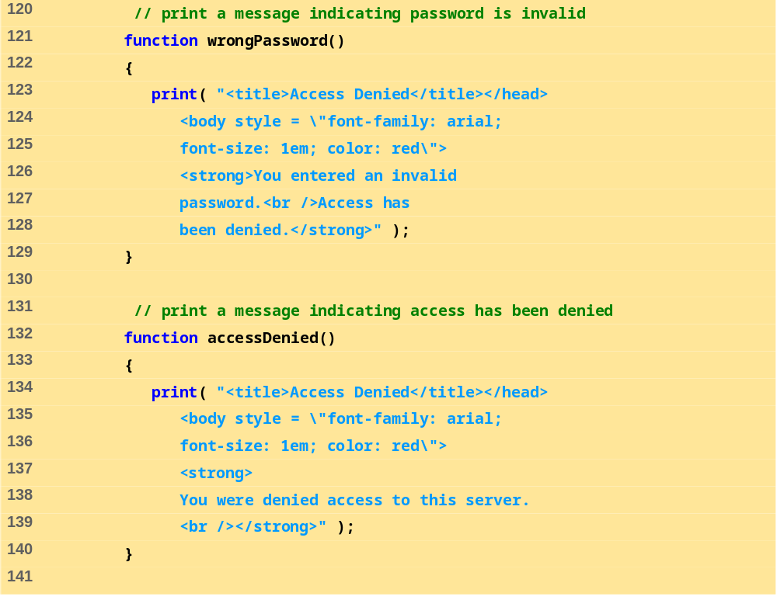
password.php
(6 of 7)
Function wrongPassword prints a message to the client indicating that the password is invalid.
Function accessDenied prints a message to the client indicating that access has been denied.

Slide 103
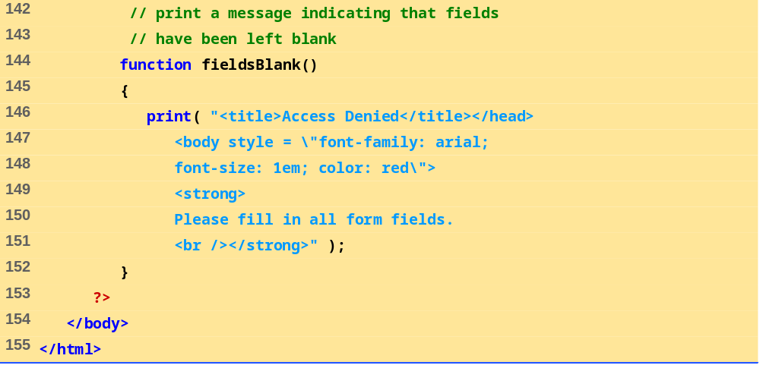
password.php
(7 of 7)
Function fieldsBlank prints a message to the client indicating that all form fields have not been completed.

Slide 104


26.6 Verifying a Username and Password
Fig. 26.16 Verifying a username and password.

Slide 105

password.txt
(1 of 1)

Slide 106
26.7 Connecting to a Database
Databases
  Store and maintain data
  MySQL is a free database product
  PHP supports many database operations
    Access databases from Web pages

Slide 107

data.html
(1 of 2)

Slide 108

data.html
(2 of 2)
Select box containing options for a SELECT query.

Slide 109

26.7 Connecting to a Database
Fig. 26.18 Form to query a MySQL database.

Slide 110
26.7 Connecting to a Database
Interacting with databases
  SQL
    Structured Query Language
    Used to manipulate databases
  Several useful functions
    mysql_connect
    mysql_select_db
    mysql_query
    mysql_error
    mysql_fetch_row
    mysql_close

Slide 111

database.php
(1 of 3)
Build the select query and assign the string to variable $query.
Function mysql_connect returns a database handle which represents PHP’s connection to a database. If this connection is not made, function die is called to terminate script execution.

Slide 112

database.php
(2 of 3)
Function mysql_query returns an object containing the result set of the query, which we assign to variable $result.
Function mysql_select_db is called to specify the database to be queried.
The for loop iterates through each record in the result set while constructing an XHTML table from the results. Variable $counter is incremented by one for each row retrieved.
Function mysql_fetch_row returns an array containing the elements of each row in the result set of our query ($result).

Slide 113

database.php
(3 of 3)
The foreach loop iterates through the array containing the elements of each row and prints out each element in an individual table cell.
The total number of results are printed to the client.

Slide 114

26.7 Connecting to a Database
Fig. 26.19 Querying a database and displaying the results.

Slide 115
26.8 Cookies
Cookies
  Store information on client computer
  Track preferences and other information
  Stored as text files on hard drive
  Never store sensitive information, such as credit card numbers, in a cookie
    Security risk
Cookies and PHP
  setcookie function
    Name
    Value
    Expiration date

Slide 116

cookies.html
(1 of 2)

Slide 117

cookies.html
(2 of 2)
Form data is posted to cookies.php.

Slide 118

26.8 Cookies
Fig. 26.20 Gathering data to be written as a cookie.

Slide 119

cookies.php
(1 of 2)
Function setcookie takes the name of the cookie to be set as the first argument, followed by the value to be stored in the cookie. The optional third argument specifies the expiration date of the cookie.

Slide 120

cookies.php
(2 of 2)
Each form field’s value is printed to confirm the data that has been set as a cookie with the user.
Hyperlink to readCookies.php.

Slide 121

26.8 Cookies
Fig. 26.21 Writing a cookie to the client.

Slide 122
26.8 Cookies
Reading cookies
  $_COOKIE environment variable
    Array
  foreach loop to access each element
    Split into key and value

Slide 123
26.8 Cookies
Cookie storage
  Internet Explorer
    Stores cookies in Cookies directory
    Text file

Slide 124


26.8 Cookies
Fig. 26.22 Cookies directory before a cookie is written.
Fig. 26.23 Cookies directory after a cookie is written.

Slide 125

readCookies.php
(1 of 2)

Slide 126

readCookies.php
(2 of 2)
The foreach loop iterates through the $_COOKIE array and prints the name and value of each cookie in an XHTML table.
PHP creates array $_COOKIE which contains all cookie values indexed by their names.

Slide 127

26.8 Cookies
Fig. 26.24 Displaying the cookie’s content.

Slide 128
26.9 Dynamic Content in PHP
Dynamically alter XHTML content
  Form’s action property set to same page that contains it
  Perform different actions when page is loaded and form is submitted
    isset variable
  Check for errors
    Write different XHTML when errors encountered
  $$variable syntax
    References variable whose name equals the value of $variable
  If input is valid, make MySQL database calls

Slide 129

dynamicForm.php
(1 of 9)
Build array of options for the form.

Slide 130

dynamicForm.php
(2 of 9)
If the page is being loaded as a result of a form submission, do error checking and then retrieve information from the database.
Check for errors or omissions in form field input.

Slide 131

dynamicForm.php
(3 of 9)
If there were no errors, query the MySQL database.

Slide 132

dynamicForm.php
(4 of 9)

Slide 133

dynamicForm.php
(5 of 9)
Halt the script so the form-generation code does not execute.

Slide 134

dynamicForm.php
(6 of 9)
Fill in the forms using $$variable syntax.
If the form input contained errors, place a red asterisk (*) next to the text field.

Slide 135

dynamicForm.php
(7 of 9)
Make sure the correct book is selected in the dropdown box.

Slide 136

dynamicForm.php
(8 of 9)
Make sure the correct OS is checked in the checkbox.

Slide 137

dynamicForm.php
(9 of 9)

Slide 138


26.9 Dynamic Content in PHP
Fig. 26.25 Dynamic form using PHP.

Slide 139


26.9 Dynamic Content in PHP
Fig. 26.25 Dynamic form using PHP.

Slide 140

formDatabase.php
(1 of 3)
Build the query string.

Slide 141

formDatabase.php
(2 of 3)

Slide 142

formDatabase.php
(3 of 3)
Retrieve each mailing list member record from the database.
Dynamically create a table containing each mailing list member.

Slide 143

26.9 Dynamic Content in PHP
Fig. 26.26 Displaying the MailingList database.

Slide 144

26.10 Operator Precedence

Slide 145

26.10 Operator Precedence

